Slide 1
Lesson-2
Programming Process and Running Programs in C

Slide 2
Objectives
To become familiar with the general form of a C program and the basic elements in a program
Understand the programming process from creation to execution
To appreciate the importance of writing comments in a program
To understand the use of data types and the differences between the data types int, double, and char
To know how to declare variables

Slide 3
Objectives
To understand how to write assignment statements to change the value of variables
To learn how C evaluates arithmetic expressions and how to write them in C
To learn how to read data values into a program and to display results
To understand how to write format strings for data entry and display

Slide 4
Objectives
To learn how to use redirection to enable the use of files for input/output
To understand the differences between syntax errors, run-time errors, and logic errors, and how to avoid them and to correct them

Slide 5
C Programming Language
A high-level programming language
Developed in 1972 by Dennis Ritchie at AT&T Bell Labs
Designed as language to write the Unix operating system
Resembles everyday English
Very popular

Slide 6
Programming is not Difficult
Is Programming Difficult?
Click Here

Slide 7
Uses of C
Mainly because it produces code that runs nearly as fast as code written in assembly language. Some examples of the use of C might be:
Operating Systems
Language Compilers
Assemblers
Text Editors
Print Spoolers
Network Drivers
Modern Programs
Data Bases
Language Interpreters
Utilities

Slide 8
Why use C?
The largest measure of C's success seems to be based on purely practical considerations:
the portability of the compiler;
the standard library concept;
a powerful and varied repertoire of operators;
an elegant syntax;
ready access to the hardware when needed;
and the ease with which applications can be optimised by hand-coding isolated procedures

Slide 9
Programming and Problem-Solving

Slide 10
Steps in Problem Solving Process
Analysis and specification of the task (problem definition)
Design of the software (object and algorithm design)
Coding(Development)
Testing and Implementation
Deployment and Maintenance and
Evolution of the system
Note: There should be proper documentation of the process.

Slide 11
Understanding and Analyzing the Problem (Example 1)
Example 1:
The personnel office of Babcock University is assigned the task of computing the monthly emolument of all category of employees of the institution
The employee taxation is based on the following constraints;

Slide 12
Understanding and Analyzing the Problem
If basic salary is less than or equal to N5000, 5% of basic salary is deducted as tax otherwise 8% deducted.
Also 10% of the employee gross pay should be deducted as part of pension scheme.
It is required that each employee pay slip should contain employee number, name, total allowance, tax, basic salary, gross pay and Net pay

Slide 13
Understanding and Analyzing the Problem
Analyse the above problem and identify the output, input and processing requirements
Draw the flowchart for the payroll system
Notes:
Trick: when you know the output requirement then you will be able to identify the input requirement/data

Slide 14
Understanding and Analyzing the Problem
Input data/requirement:
Employee Number
Employee Name
Basic salary
Housing allowance
Transport allowance
Meal subsidy

Slide 15
Understanding and Analyzing the Problem
Processing requirements:
If Basic salary is <=5000, Tax = 5% of Basic salary
Else Tax = 8% of basic salary.
Total allowances = Housing + Transport + meal subsidy
Gross Pay = Basic salary + Total allowances
Contributory pension= 10% of Gross Pay
Net pay = Gross pay – (Tax + contributory pension)

Slide 16
Understanding and Analyzing the Problem
Solution:
Output requirements:
Employee Number
Employee Name
Total allowance
Tax
Contributory Pension
Basic salary
Gross pay
Net pay

Slide 17
Algorithms
Algorithm
A sequence of precise instructions that leads to a solution
Program
An algorithm expressed in a language the computer can understand
Display ALG.

Slide 18
Program Design
Programming is a creative process
No complete set of rules for creating a program
Program Design Process
Problem Solving Phase
Result is an algorithm that solves the problem
Implementation Phase
Result is the algorithm translated into a programming language

Slide 19
Problem Solving Phase
Be certain the task is completely specified
What is the input?
What information is in the output?
How is the output organized?
Develop the algorithm before implementation
Experience shows this saves time in getting your program to run.
Test the algorithm for correctness

Slide 20
Implementation Phase
Translate the algorithm into a programming language
Easier as you gain experience with the language
Compile the source code
Locates errors in using the programming language
Run the program on sample data
Verify correctness of results
Results may require modification of the algorithm and program
Display IMPL.

Slide 21
Creating and Executing a Program
input data
the data values that are scanned by a program
program output
the lines displayed by a program

Slide 22
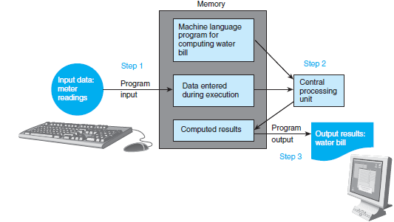
Flow of Information During Program Execution

Slide 23
Testing and Debugging
Bug
A(n) mistake(error) in a program
Debugging
Eliminating mistakes(errors) in programs
Term used when a moth caused a failed relay on the Harvard Mark 1 computer. Grace Hopper and other programmers taped the moth in logbook stating: “First actual case of a bug being found.”

Slide 24
Common Programming Errors
Syntax errors
Violation of the grammar rules of the language
Discovered by the compiler
Error messages may not always show correct location of errors
Run-time errors
Error conditions detected by the computer at run-time
an attempt to perform an invalid operation
Logic errors
Errors in the program’s algorithm
Most difficult to diagnose
Computer does not recognize an error

Slide 25
Quick Review
Can you…
Describe the first step to take when creating a program?
List the two main phases of the program design process?
Explain the importance of the problem-solving phase?
List the steps in the software life cycle?

Slide 26
Quick Review
Can you…
Describe the three kinds of program errors?
Tell what kind of errors the compiler catches?
What kind of error is produced if you forget a punctuation symbol such as a semi-colon?
Tell what type of error is produced when a program runs but produces incorrect results?

Slide 27
C-Language Elements
preprocessor
a system program that modifies a C program priori to its compilation
library
a collection of useful functions and symbols that may be accessed by a program
each library has a standard header file whose name ends with the symbols “.h”
stdio.h

Slide 28
C-Language Elements
preprocessor directive
a C program line beginning with # that provides an instruction to the preprocessor
#include <stdio.h>
#define KMS_PER_MILE 1.609

Slide 29
C-Language Elements
constant macro
a name that is replaced by a particular constant value before the program is sent to the compiler
#define KMS_PER_MILE 1.609
constant macro
constant
kms = KMS_PER_MILE * miles;

Slide 30
C-Language Elements
comment
text beginning with /* and ending with */ that provides supplementary information but is ignored by the preprocessor and compiler
Multiple lines-/* Get the distance in miles */
Single line-//

Slide 31
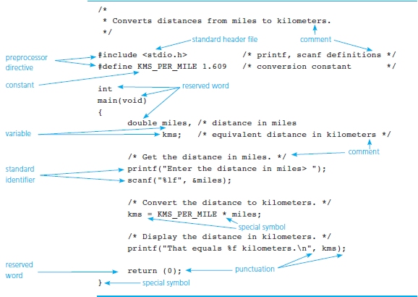
C Language Elements in Miles-to-Kilometers Conversion Program

Slide 32
Function main
Every C program has a main function.
These lines mark the beginning of the main function where program execution begins.
int
main (void)

Slide 33
Function main
declarations
the part of a program that tells the compiler the names of memory cells in a program
executable statements
program lines that are converted to machine language instructions and executed by the computer

Slide 34
C-Language Elements
reserved word
a word that has a special meaning in C
identifiers from standard library and names for memory cells
appear in lowercase
cannot be used for other purposes
return 0;

Slide 35
C-Language Elements
standard identifier
a word having special meaning but one that a programmer may redefine
redefinition is not recommended
printf(“Enter the distance in miles “);

Slide 36
User-defined identifiers (Variables)
These name memory cells that hold data and program results and to name operations that we define.
Naming rules:
An identifier must consist only of letters, digits and underscores.
An identifier cannot begin with a digit.
A C reserved word cannot be used an an identifier.
An identifier defined in a C standard library should not be redefined.
5.An identifier is case sensitive.

Slide 37
Implementing Miles-to-Kilometers Conversion Program
Run Code
See Code

Slide 38
Variable Declarations AND Definition
variable
a name associated with a memory cell whose value can change
variable declarations
statements that communicate to the compiler the names of variables in the program and the kind of information stored in each variable(data type)

Slide 39
Variable Declarations
C requires you to declare every variable used in a program.
A variable declaration begins with an identifier that tells the C compiler the type of data store in a particular variable.
int hours;
double miles;

Slide 40
Data Types
int
a whole number
435
Double(double has 2x more precision than float)
a real number with an integral part and a fractional part separated by a decimal point
3.14159
char
an individual character value
enclosed in single quotes
‘A’, ‘z’, ‘2’, ‘9’, ‘*’, ‘!’

Slide 41
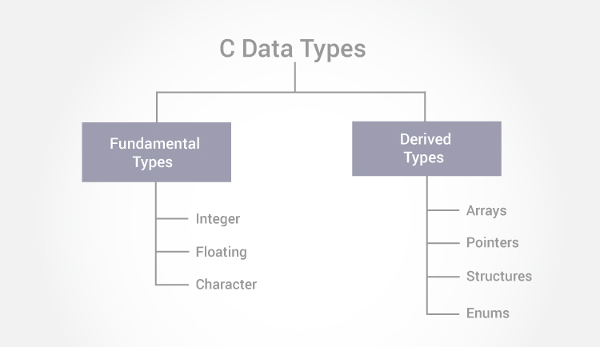
C-Data Types
Floating type variables can hold real numbers such as: 2.34, -9.382, 5.0 etc
The size of float (single precision float data type) is 4 bytes. And the size of double (double precision float data type) is 8 bytes.

Slide 42
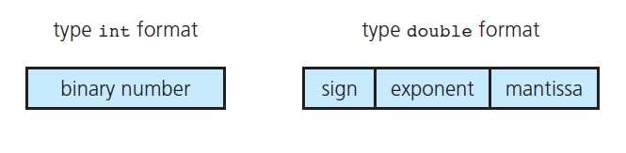
Internal Format of Type int and Type double

Slide 43
Executable Statements
Follow the declarations in a function.
Used to write or code the algorithm and its refinements.
Are translated into machine language by the compiler.
The computer executes the machine language version.

Slide 44
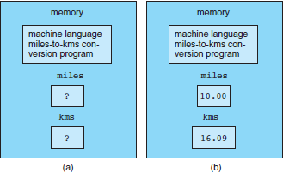
Memory (a) Before and (b) After Execution of a Program

Slide 45
Executable Statements
assignment statement
an instruction that stores a value of a computational result in a variable
kms = KMS_PER_MILE * miles;

Slide 46
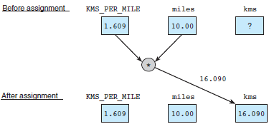
Effect of kms = KMS_PER_MILE * miles;

Slide 47
Executable Statements
Assignment is not the same as an algebraic equation.
The expression to the right of the assignment operator is first evaluated.
Then the variable on the left side of the assignment operator is assigned the value of that expression.
sum = sum + item;

Slide 48
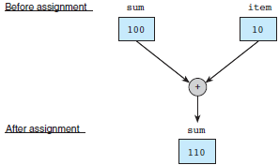
Effect of sum = sum + item;

Slide 49
Input /Output Operations and Functions
input operation
an instruction that copies data from an input device into memory
output operation
an instruction that displays information stored in memory
input/output function
a C function that performs an input or output operation
function call
calling or activating function

Slide 50
The printf Function
Displays a line of program output.
Useful for seeing the results of a program execution.
printf(“That equals %f kilometers. \n”, kms);

Slide 51
The printf Function
function argument
enclosed in parentheses following the function name
provides information needed by the function
printf(“That equals %f kilometers. \n”, kms);
function name

Slide 52
The printf Function
format string
in a call to printf, a string of characters enclosed in quotes, which specifies the form of the output line
printf(“That equals %f kilometers. \n”, kms);

Slide 53
The printf Function
print list
in a call to printf, the variables or expressions whose values are displayed
placeholder
a symbol beginning with % in a format string that indicates where to display the output value
printf(“That equals %f kilometers. \n”, kms);

Slide 54
Placeholders in format string
Placeholder | Variable Type | Function Use
% c | char | printf/scanf
% d | int | printf/scanf
% f | double | printf
% lf | double | scanf

Slide 55
The scanf Function
Copies data from the standard input device (usually the keyboard) into a variable.
scanf(“%lf”, &miles);
scanf(“%c%c%c”, &letter_1, &letter_2, &letter_3);

Slide 56

Effect of scanf("%lf", &miles);

Slide 57
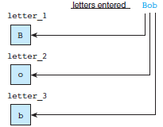
Scanning Data Line Bob

Slide 58
The return Statement
Last line in the main function.
Transfers control from your program to the operating system.
The value 0 is optional; indicates that your program executed without an error.
return (0);

Slide 59
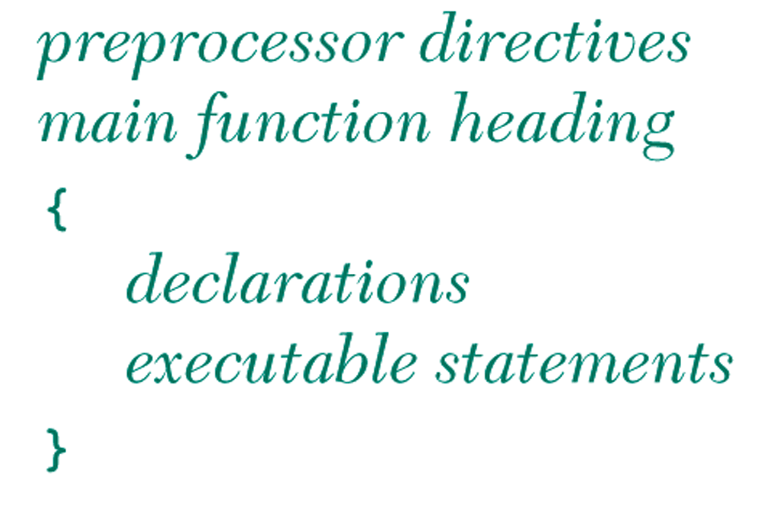
General Form of a C Program

Slide 60
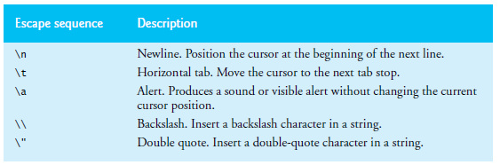
Escape Sequence
Notice that the characters \n were not printed on the screen. The backslash (\) is called an escape character. It indicates that printf is supposed to do something out of the ordinary. The escape sequence \n means newline. Some Common escape sequences are as follows:

Slide 61
Class Work
1.Write the following in C
i).Babcock University
ii).Babcock
University
2.Write out numbers from 1 to 10 on the same line and also on separate line
3. Create a program that prints your name, address and Phone number
4. Given a = 5, b = 1, x = 10, and y = 5, create a program that outputs the result of the formula
f = (a- b)(x-y) using a single printf() function
5. Create a program that uses escape sequence \" to print your favorite quote.
6. Create a new program that prompts a user for numbers and determines total revenue using the following formula: Total Revenue = Price * Quantity.
7. Build a new program that prompts a user for data and determines a commission using the following formula: Commission = Rate * (Sales Price – Cost).

Slide 62
Program Style
Use spaces consistently and carefully.
One is required between consecutive words in a program.
Improves readability.
Use comments to document your program.
Also enhances readability.

Slide 63
Arithmetic Operators
Arithmetic Operator | Meaning | Example
+ | addition | 5 + 2 is 7 5.0 + 2.0 is 7.0
– | subtraction | 5 – 2 is 3 5.0 – 2.0 is 3.0
* | multiplication | 5 * 2 is 10 5.0 * 2.0 is 10.0
/ | division | 5.0 / 2.0 is 2.5 5 / 2 is 2
% | remainder | 5 % 2 is 1

Slide 64
Data Type of an Expression
mixed-type expression
an expression with operands of different types
mixed-type assignment
the expression being evaluated and the variable to which it is assigned have different data types
type cast
converting an expression to a different type by writing the desired type in parentheses in front of the expression

Slide 65
Expressions with Multiple Operators
unary operator
an operator with one operand
unary plus (+), unary negation (-)
ex. x = -y;
binary operator
an operator with two operands
ex. x = y + z;

Slide 66
Rules for Evaluating Expressions
Parentheses rule
all expression must be evaluated separately
nested parentheses evaluated from the inside out
innermost expression evaluated first
Operator precedence rule
unary +, - first
*, /, % next
binary +, - last

Slide 67
Rules for Evaluating Expressions
Right Associativity
Unary operators in the same subexpression and at the same precedence level are evaluate right to left.
Left Associativity
Binary operators in the same subexpression and at the same precedence lever are evaluated left to right.

Slide 68
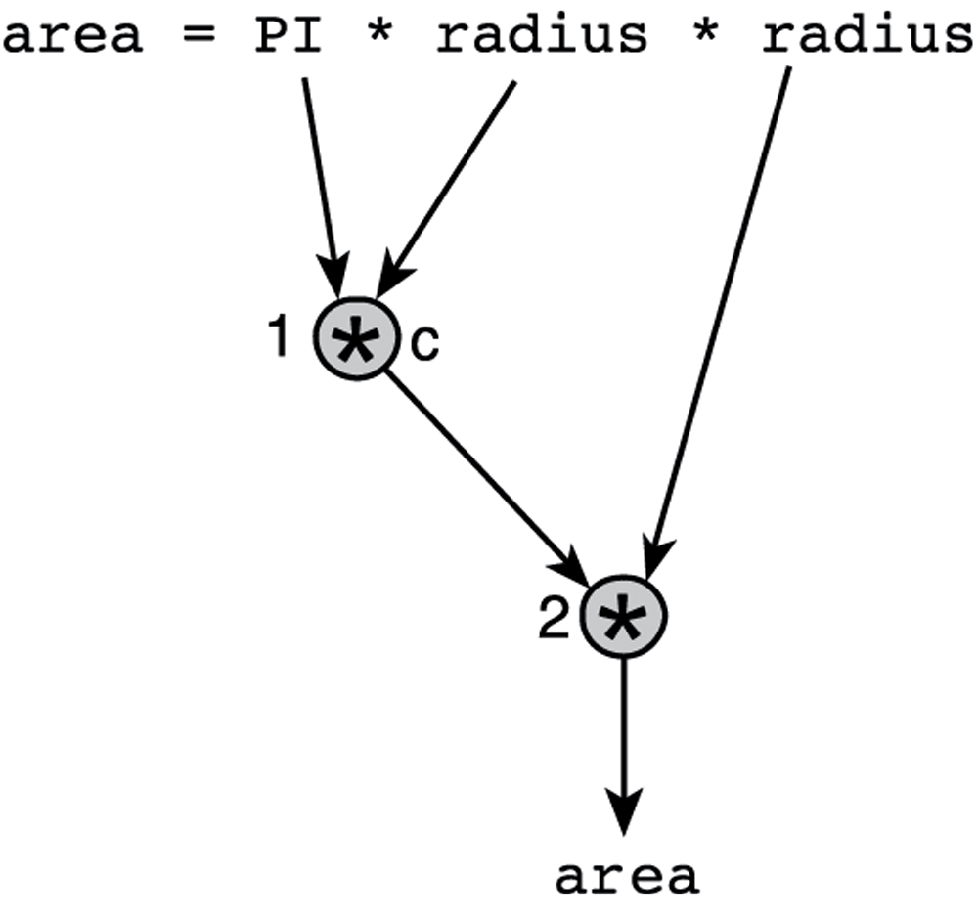
Evaluation Tree for area = PI * radius * radius;

Slide 69
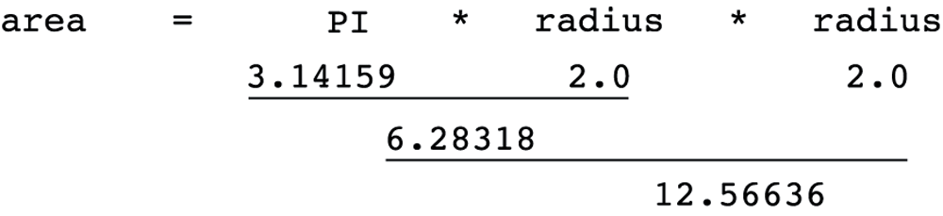
Step-by-Step Expression Evaluation

Slide 70
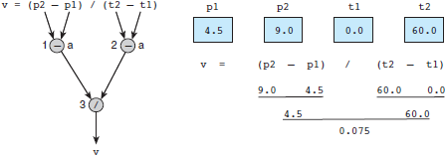
Evaluation Tree and Evaluation for v = (p2 - p1) / (t2 - t1);

Slide 71
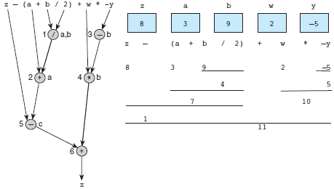
Evaluation Tree and Evaluation for z - (a + b / 2) + w * -y

Slide 72
Numerical Inaccuracies
representational error
an error due to coding a real number as a finite number of binary digits
cancellation error
an error resulting from applying an arithmetic operation to operands of vastly different magnitudes
effect of smaller operand is lost

Slide 73
Numerical Inaccuracies
arithmetic underflow
an error in which a very small computational result is represented as zero
arithmetic overflow
an error that is an attempt to represent a computational result that is too large

Slide 74
Mathematical Expressions
Write in C-Language
P(x) = x4 + 7x3 - 5x + 9

Slide 75
Profit Wizard Program
Case Study(CS)

Slide 76
Figure 2.13
Profit Wizard Program
Example-1
The Profit Wizard program uses concepts, such as variables, input and output with printf() and scanf() functions, and beginning arithmetic operators.
SEE CODE→
RUN CODE→

Slide 77
Formatting Numbers in Program Output
field width
the number of columns used to display a value
When formatting doubles, you must indicate the total field width needed and the number of decimal places desired.

Slide 78
Interactive Mode, Batch Mode, and Data Files
interactive mode
a mode of program execution in which the user responds to prompts by entering (typing in) data
batch mode
a mode of program execution in which the program scans its data from a previously prepared data file

Slide 79
Wrap Up
Every C program has preprocessor directives and a main function.
The main function contains variable declarations and executable statements.
C’s data types enable the compiler to determine how to store a value in memory and what operations can be performed on that value.

Slide 80
Lesson-2 -- End

Slide 81
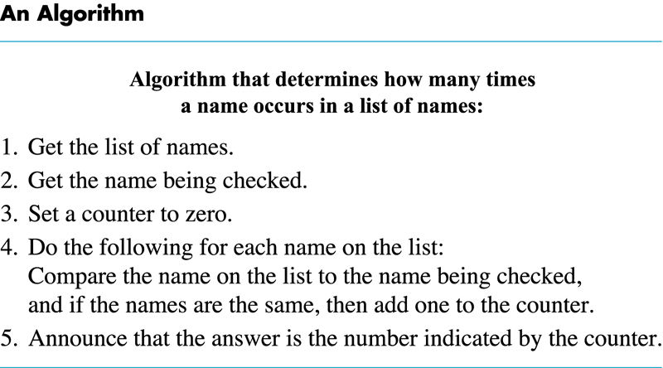
Display ALG.
Back
Next

Slide 82

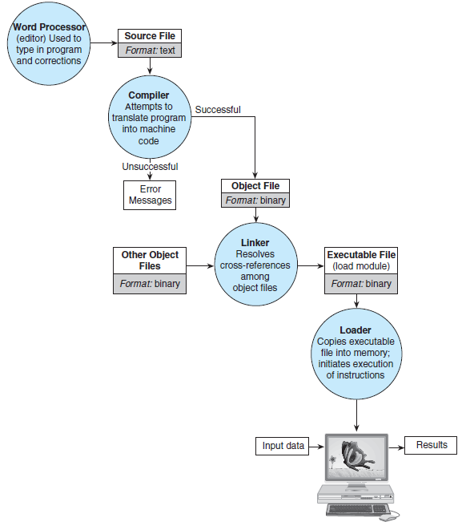

Program execution Process: Entering, compiling, and Running a Program

Slide 83
Miles-Km-Conversion Code
/*
Converts distances from miles to kilometers
*/
#include <stdio.h> /* printf, scanf definitions*/
#define KMS_PER_MILE 2.5 /*Conversion constants*/
int
main(void)
{
float miles, /*distance in miles*/
kms;
/*Get the distance in miles*/
printf("Enter the distance in miles:");
scanf("%1f", &miles);
/*Convert the distance to kilometers*/
kms = KMS_PER_MILE * miles;
/*Display the distance in kilometers.*/
printf("That equals %1f kilometers.\n", kms);
return(0);
}
←BACK

Slide 84
Profit Wizard
/*
*Determines the profit made
*/
#include <stdio.h>
main()
{
int qty, float sellingprice,float totcostprice,
float totsellingprice;
float fRevenue, fCostprice;
fRevenue = 0;
fCost = 0;
/* Computing total cost price of items */
printf(“Enter cost price per unit:”)
scanf(“%2f”, &fCostprice);
printf(“Enter quantity of items:”);
scanf(“%d”, &int qty);
totcostprice = qty*fCostprice;
/*-------------------------------------------*/
printf(“\nThe total Cost Price is $%.2f\n”, totcostprice);
/*Compute total selling Price of items*/
printf(“\nEnter selling price per unit:”);
scanf(“%2f”, &fsellingprice);
totsellingprice = qty*sellingprice;
/*Compute Revenue*/
fRevenue = totsellingprice-totcostprice;
/*Display the Revenue*/
printf(“\nThe Revenue is determined as $%.2f\n”, fRevenue);
}
←BACK

